Slide 1
MELVIN OLIVE III
The Interview web Application

Slide 2





Programming Languages:
Python
HTML
CSS
FLASK(framework)
FLASKR
JAVASCRIPT
JSON
JQUERY

Slide 3
PROJECT OUTLINE:
HTML Functionality :
HomePage
Username/Login Functionality
Navigation bar with FAQ page and About page
Faq Page
Blank
About Page
Interviews Page
User information
Candidate Page
Create new candidates through this page
2. Sign Up Process

Slide 4
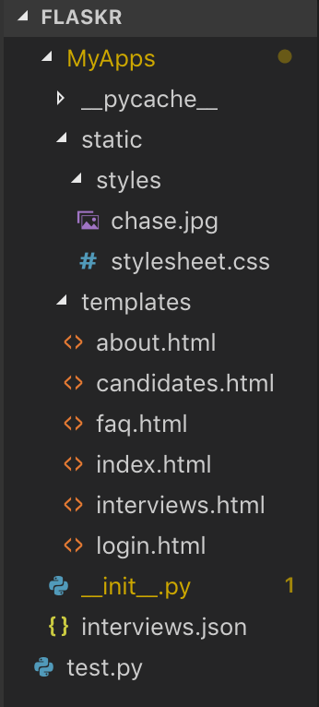
PROJECT STRUCTURE
The project is developed using the Flask framework.
Within this Flask framework I utilized different programming languages to develop the project.
Static folders are designated for styling the application.
The template folder is designated for all html functionality or html files
Python files are designated to go under the template folder

Slide 5
How I got Started
I began developing the project with HTML/CSS two programming languages I already had familiarity with.
Next began the use of Python some javascript and eventually Json data aggregated from a html form.

Slide 6
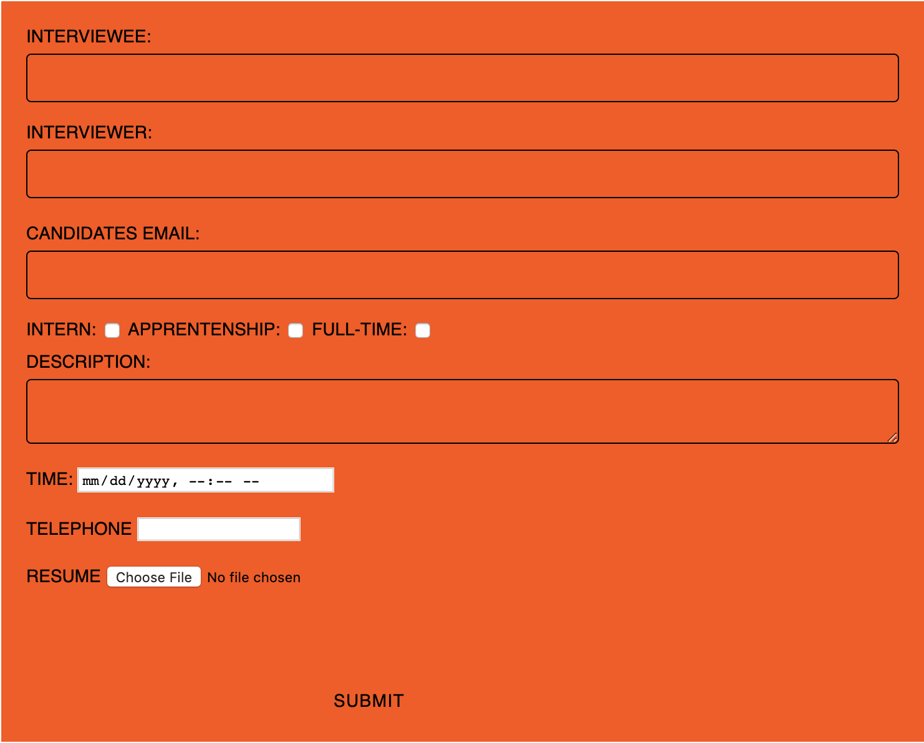
Where Does Everything Tie in?
The central key component of the project is a active HTML form.

Slide 7
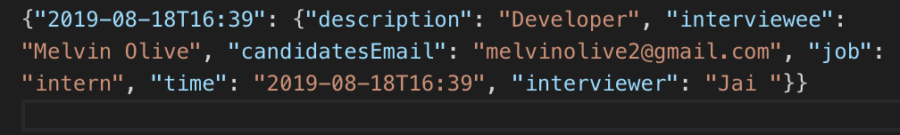
Information
The HTML form passes information from the user to a local database.

Slide 8
How did I get User Data:
By using Jinja Loops I was able to create an active form from a HTML file to a python file which eventually added data to a JSON file.

Slide 9
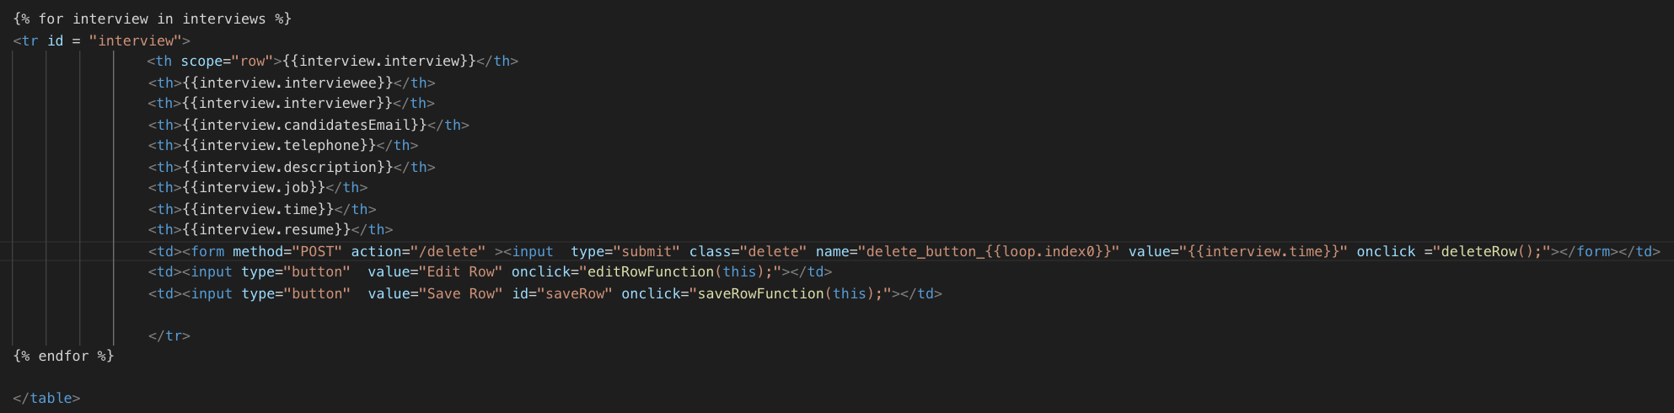
] Jinja Loops
By utilizing a button type for submit once the user clicks the submit button the form data will be used by the JINJA loops
Next the form data will be posted to python for use to store in a json file.

Slide 10
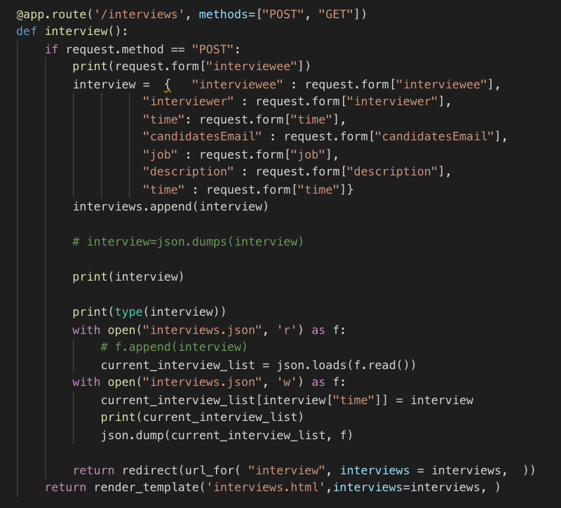
How did I get User Data:
By using Jinja Loops I was able to create an active form from a HTML file to a python file which eventually added data to a JSON file.

Slide 11
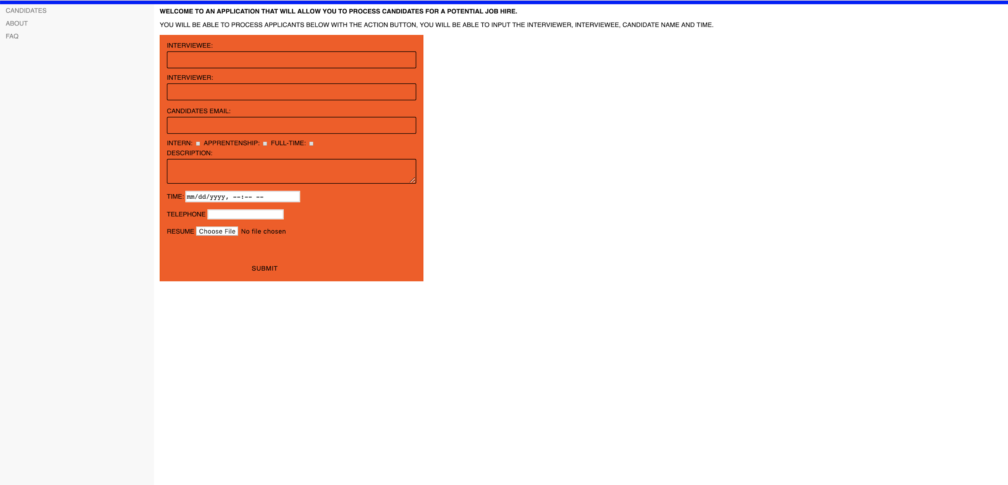

Slide 12
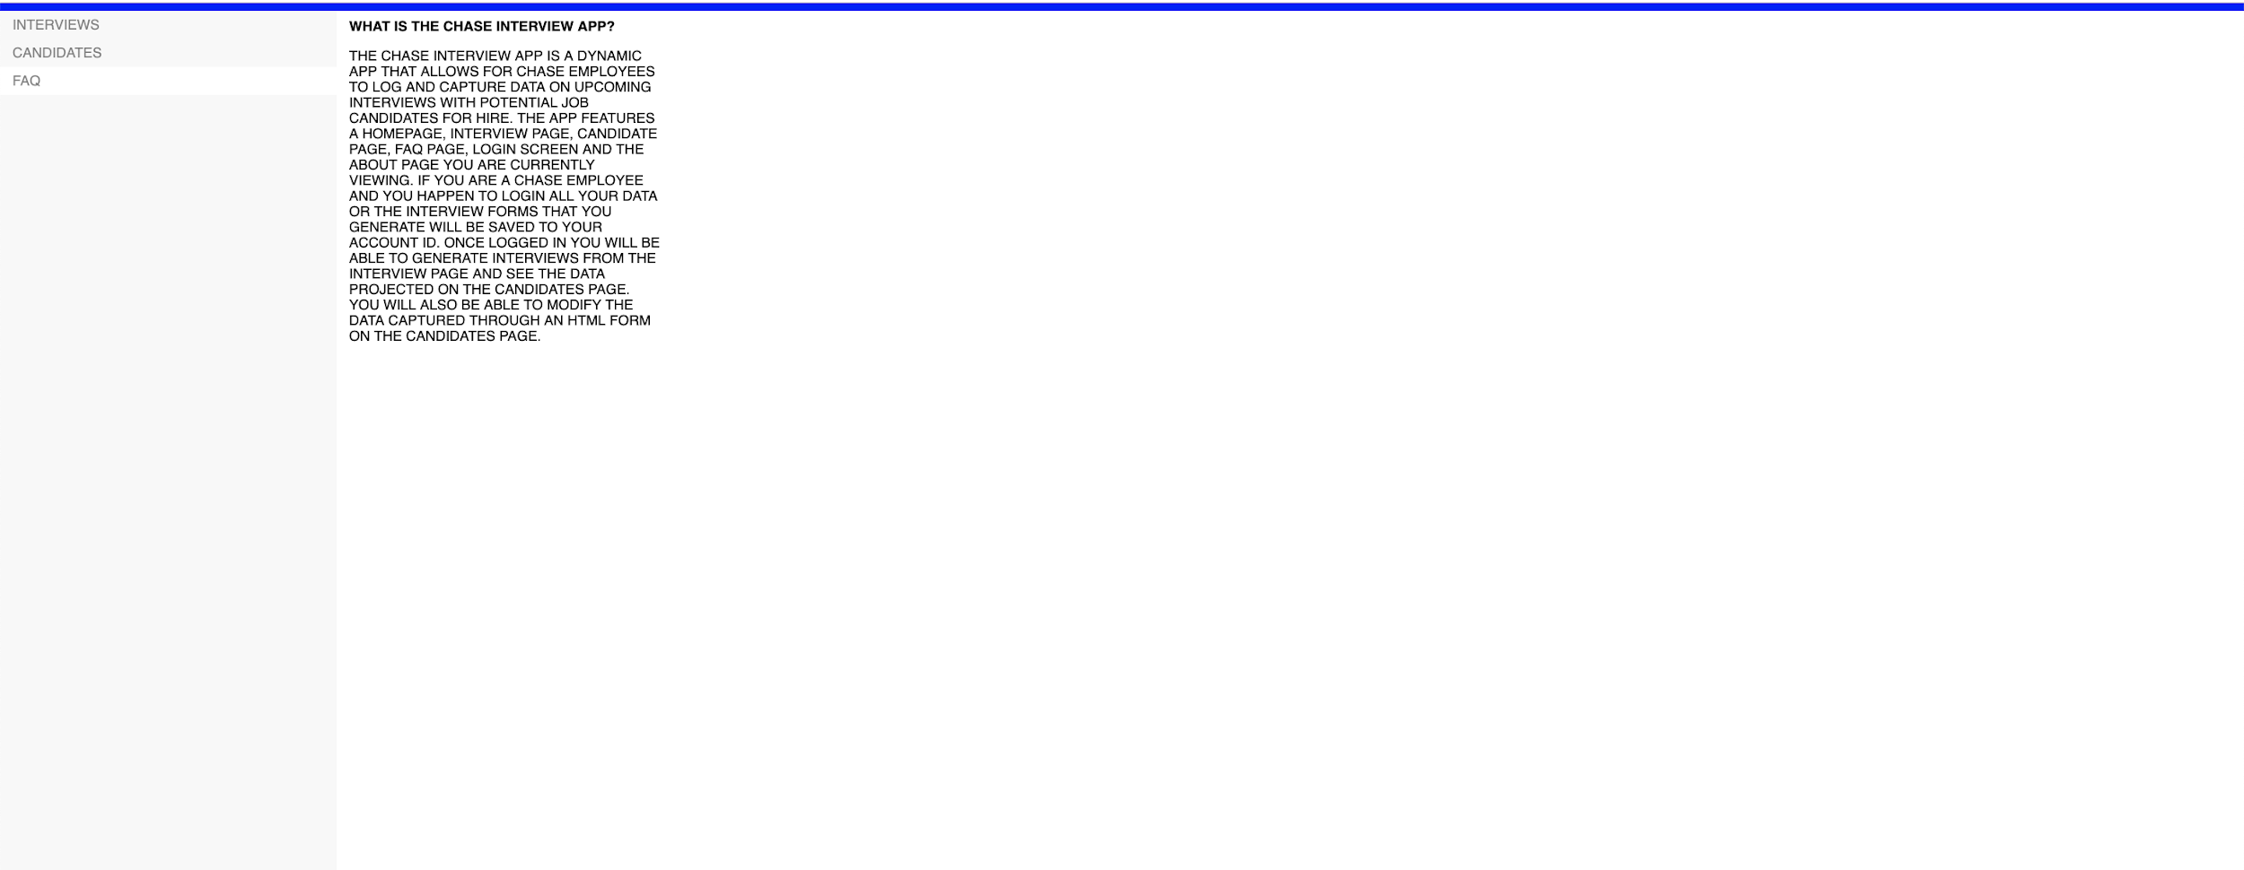

Slide 13


